Slide 1
“Implementing Machine Learning tools and/or techniques in Crime Prediction- A Research Proposal”
Simbiso Makunde
RESEARCH METHODS AND PROFESSIONAL PRACTICE MODULE
MSc Data Science

Slide 2
Contents
Artefacts and Timeline
Ethical Consideration
Methodology
Key Literature
Aims and Objectives
Research Problem and Question

Slide 3
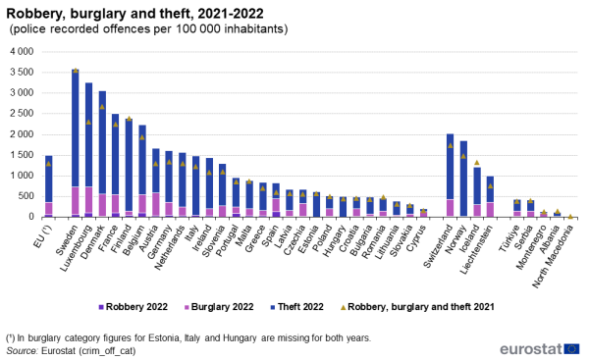
Research Problem and Question
Police recorded robberies in the EU increased by 9.7% between 2021 and 2022 (Eurostat , 2024).
Crime experienced by individuals and households in England and Wales increased by 10% between 2023 and 2024 (BBC, 2024).
Crime prediction algorithms are a useful tool for various stakeholders in their law enforcement strategies.

Slide 4
Research Question:
A machine learning forecasting model can predict 1.4 to 2.2 times as much crime as a crime analyst, (Mohler, 2015 ).
ML Models can be used as crime forecasting tools by monitoring and analysing surveillance videos.
“How can Machine learning tools and algorithms be ethically and effectively implemented to improve the accuracy and efficiency of predictive policing?”

Slide 5
Aims and Objectives
To review the existing literature and algorithms in crime prediction.
To collect , pre-process and analyse historical crime datasets.
To develop and evaluate the performance of various predictive models

Slide 6
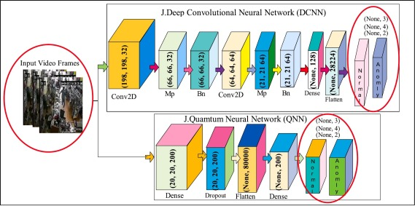
Key Literature
”Detection of Anomaly in Surveillance Videos using Quantum Convolutional Neural Networks” – Amin et al , 2023
A study of the use of Convolutional Neural Networks and quantum computing to improve the accuracy of a classification algorithm in classifying anomalous activity in real-time surveillance systems.

Slide 7
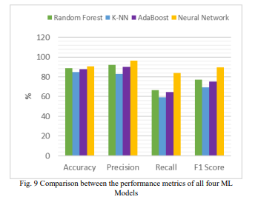
“Crime Prediction and Forecasting using Machine Learning Algorithms” - Azwad et al, 2021
various models such as Random Forests, Neural Network, K-Nearest-Neighbours and AdaBoost were developed to identify crime hotspots in large cities.

Slide 8
“Crime Prediction Model using Deep Neural Networks” - Chun et al, 2019
Research into the use of a Neural Network model to forecast whether or not an individual is likely to commit a crime in future years given historical records,
what level of crime is likely to be committed.
94% accuracy

Slide 9
“Randomized Controlled Field Trials of Predictive Policing” - Mohler et al, 2019
there can be biases in the training datasets and the can result in stigmatisation of certain individuals in society.

Slide 10
Methodology
Data Collection
FBI Crime Controller
Pre-processing
Data Cleaning
Development of ML Models
SVM
Performance Evaluation
Accuracy
Data.Gov
Normalisation
Random Forests
Neural Networks
F1 Score

Slide 11

Ethical Consideration
Bias and discrimination in law enforcement measures. (Barocas & Selbst,2016).
Data professionals must ensure that the research design complies with data protection legal frameworks .
Providing clear information about how predictions are made, and how the law enforcement agencies use the data in policing (Olaye & Egon , 2024)

Slide 12
Artefacts and Timeline
ML Predictive Model
A Dashboard for crime monitoring .
Technical report .

Slide 13
Timeline of proposed activities
Data Collection & Pre-processing - 3 Weeks
EDA - 2 Weeks
Development of Models- 4 Weeks
Performance Evaluation- 3 Weeks
Documentation- 3 Weeks

Slide 14
The End

Slide 15
References:
Ae Chun, S. et al. (2019).Crime Prediction Model using Deep Neural Networks. Proceedings of the 20th Annual International Conference on Digital Government Research, 512-514, DOI:10.1145/3325112.3328221
Alsaedi, N. et al. (2017). Can We Predict a Riot? Disruptive Event Detection Using Twitter. ACM Transactions on Internet Technology. 17(2). 1-26. DOI:10.1145/2996183
Amin, J. et al. (2023). Detection of anomaly in surveillance videos using quantum convolutional neural networks. Image and Vision Computing. 135, 1-12. DOI:10.1016/j.imavis.2023.104710

Slide 16
Azwad,T. et al. (2021). Crime Prediction and Forecasting using Machine Learning Algorithm. International Journal of Computer Science and Information Technologies, 12(2), 26-33.
Barocas, S., & Selbst, A. D.(2016). Big Data’s Disparate Impact. California Law Review, 104, 671-732. DOI: https://dx.doi.org/10.2139/ssrn.2477899
BBC (2024). Crime up 10% over past year in England and Wales, ONS says. Available at https://www.bbc.com/news/articles/cpwr89rv9qno [Accessed: 27 December 2024]

Slide 17
Eurostat (2024). Crime Statistics. Available at https://ec.europa.eu/eurostat/statistics-explained/index.php?title=Crime_statistics#:~:text=Police%2Drecorded%20crimes%20against%20property,compared%20with%20the%20previous%20year. [Accessed: 22 December 2024]
Mohler, G. O. et al. (2015). Randomized Controlled Field Trials of Predictive Policing. Journal of the American Statistical Association, 110(512), 1399–1411. DOI:10.1080/01621459.2015.1077710
Olaoye, F. & Egon, A. (2024). Predictive Policing and Crime Prevention. Crime & Delinquency. Available at: https://www.researchgate.net/publication/383565286_Predictive_Policing_and_Crime_Prevention [Accessed: 29December 2024]

